Slide 1

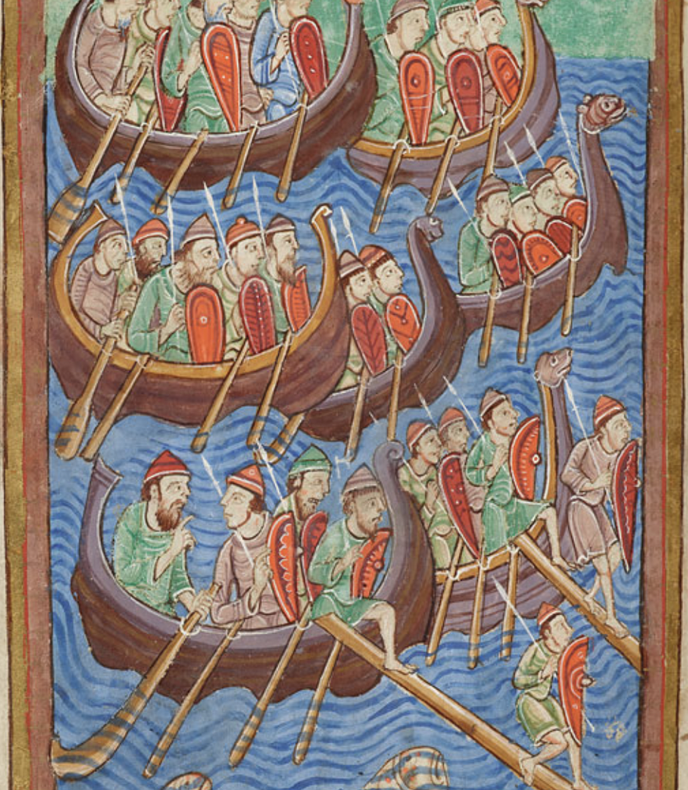
Prelims 2 650-1350
Old English and Old Norse

Slide 2
The Domesday Stone, Lindisfarne Priory
Notes:
Domesday Stone, Lindisfarne Priory, 9th century, Attack on Lindisfarne, 793

Slide 3
Battle of Stamford Bridge, Cambridge University Library Ee.3.59, 32v
Notes:
Battle of Stamford Bridge, from Life of King Edward the Confessor, Cambridge, Cambridge University Library, Ee.3.59 fol. 32v, c. 1250-60. 1066

Slide 4
Martyrdom of King Edmund, Morgan Library MS M 736, 14r
Notes:
Martyrdom of St Edmund, Morgan Library MS M 736, fol. 14r. Martyrdom of St Edmund in 870.

Slide 5
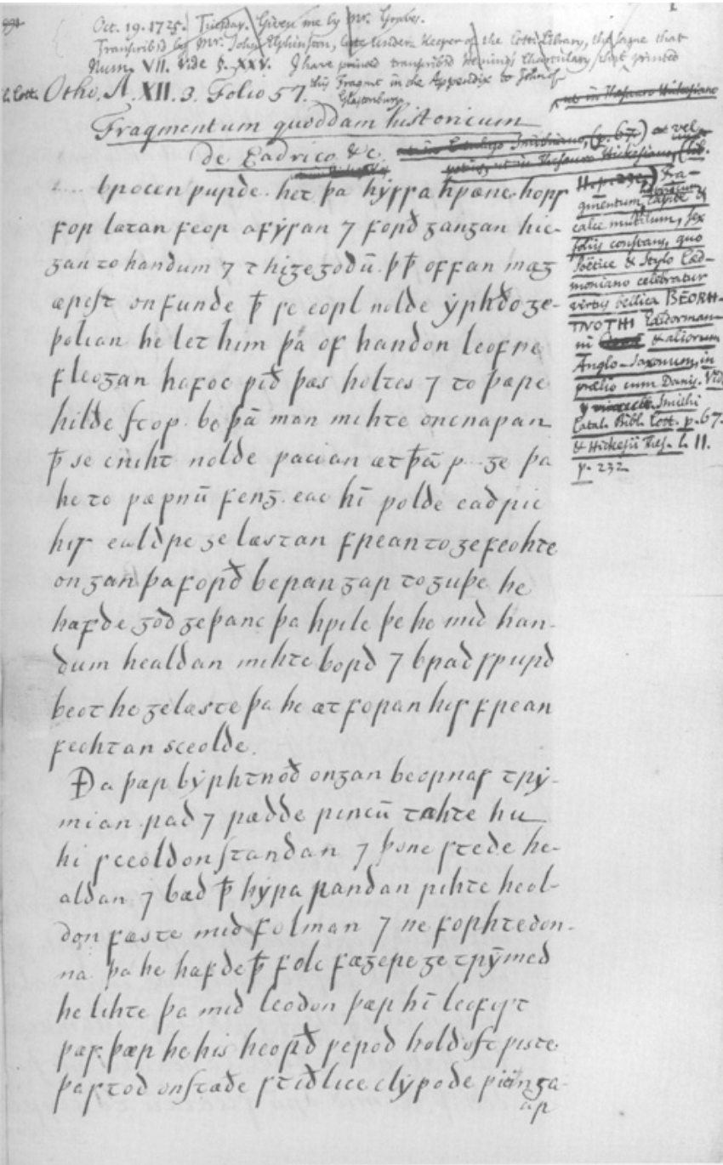
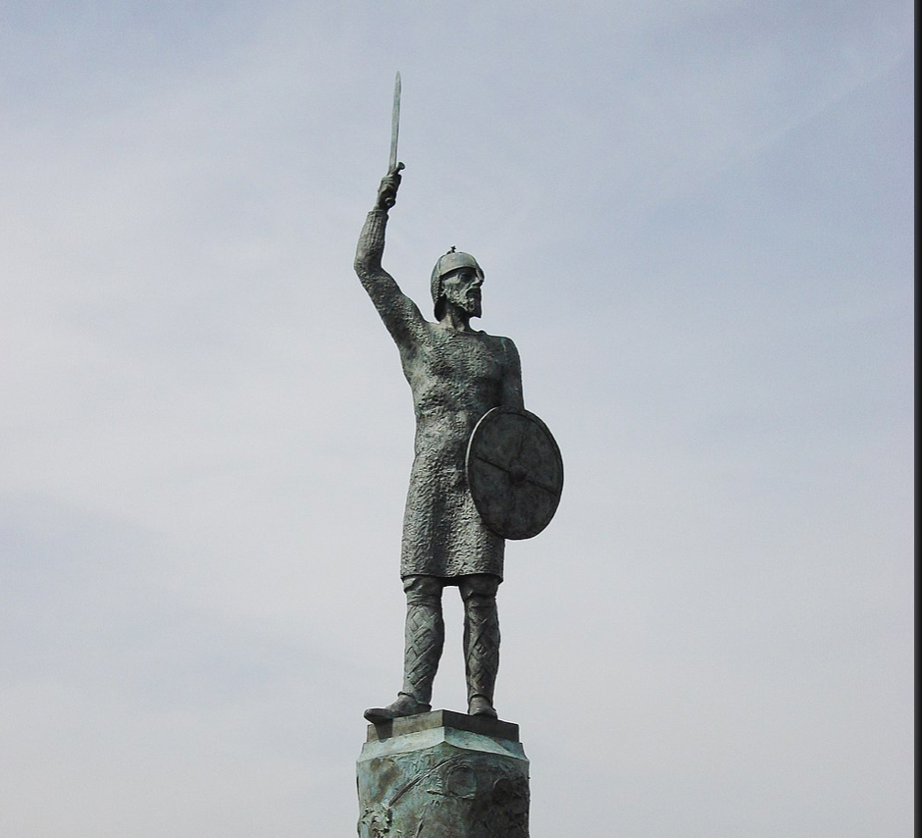
Statue of Byrthnoth, Maldon
Transcript of Battle of
Maldon

Slide 6
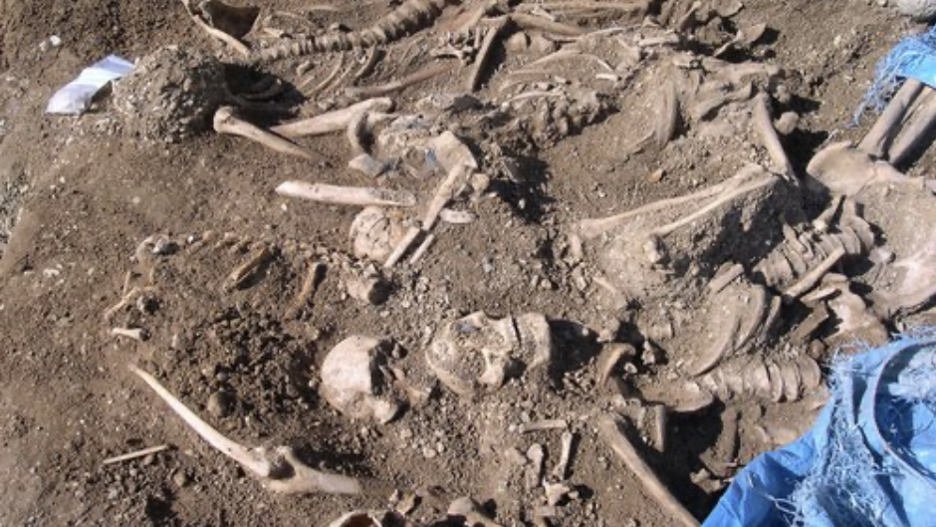
Kendrew Quad, St John’s
Notes:
1002 St Brice’s Day massacre or Oxford massacre. Site found in St John’s College in 2008 under Kendrew Quad, men aged between 16 and 25, victims of violence. Probably recent arrivals because one has been identified as half-brother of skeleton found in Denmark. Recent travel between them.

Slide 7
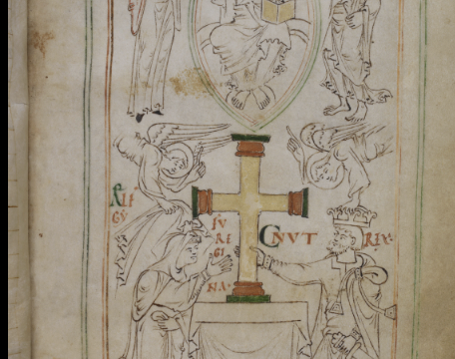
Liber vitae, New Minster, c. 1031
Notes:
New Minster, Liber vitae, c. 1031. Reign of King Cnut, 1016-1035

Slide 8
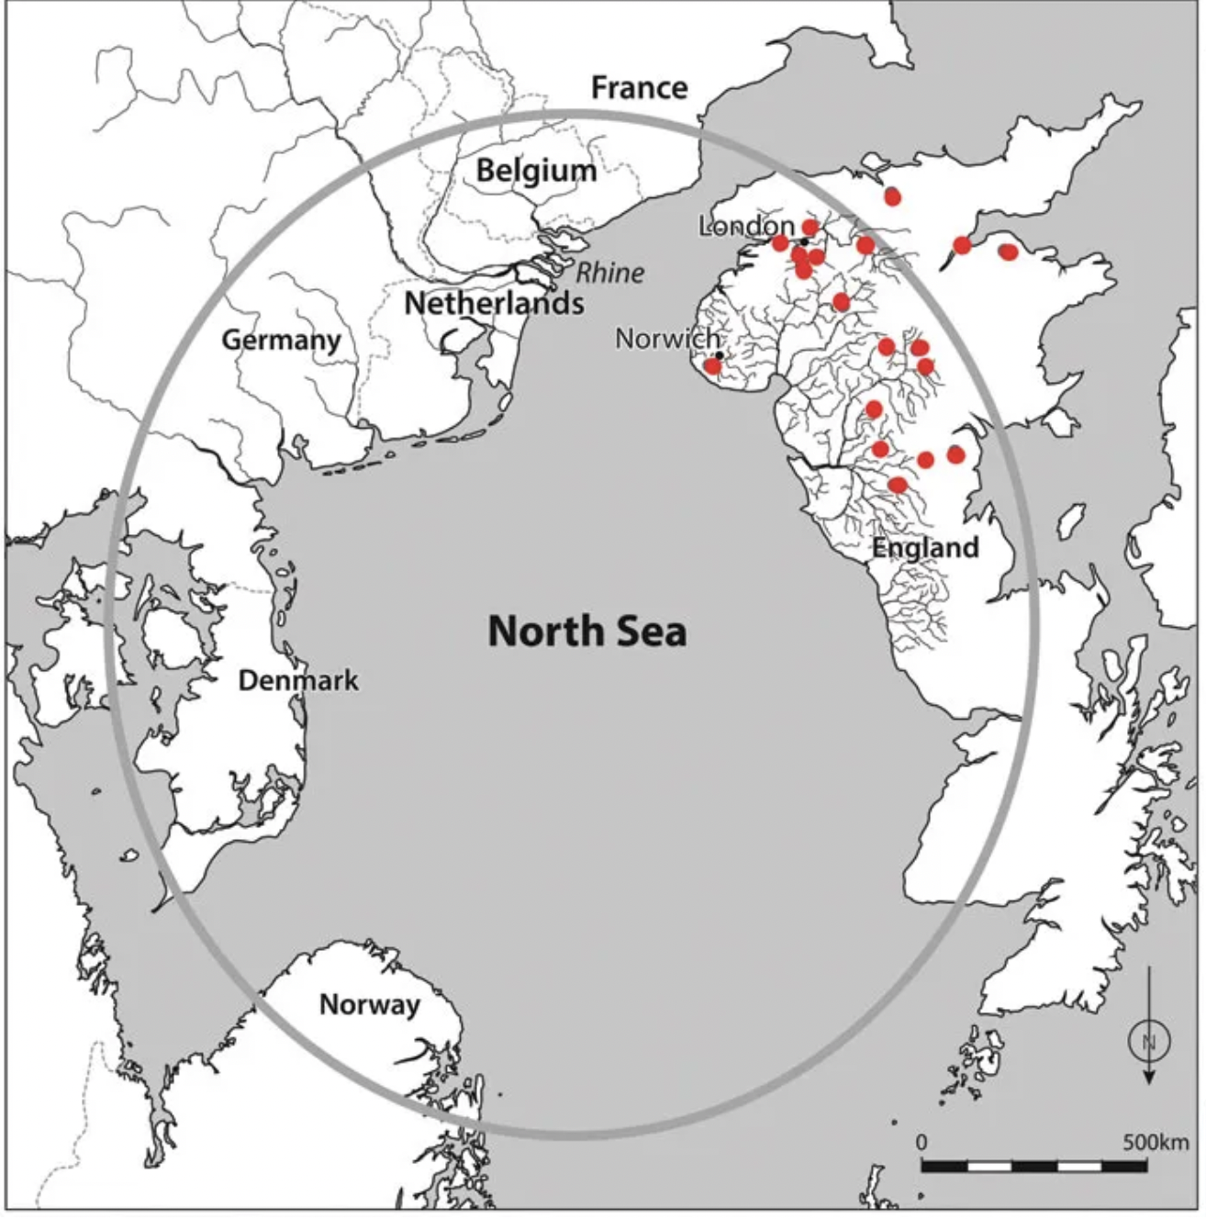
From Susan Oosthuizen, The Emergence of the English (2019)
Notes:
From Susan Oosthuizen’s book, The Emergence of the English. The North Sea as one cultural area, Red dots are IKEA stores. Cat Jarman, The River Kings -

Slide 9
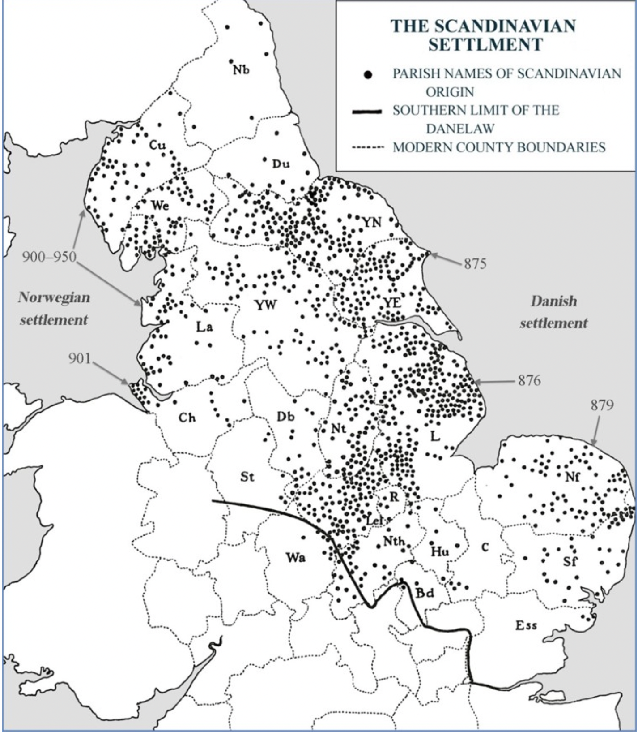
From A. H. Smith, 1956, in Interdisciplinary Approaches to the Scandinavian Heritage of North-West England.
Notes:
Place-names: names in –by, -Thorpe, -thwaite (Miss Satterthwaite). York and the Five Boroughs. Miklegate in York (gate: ON gata, street). Main Street.

Slide 10
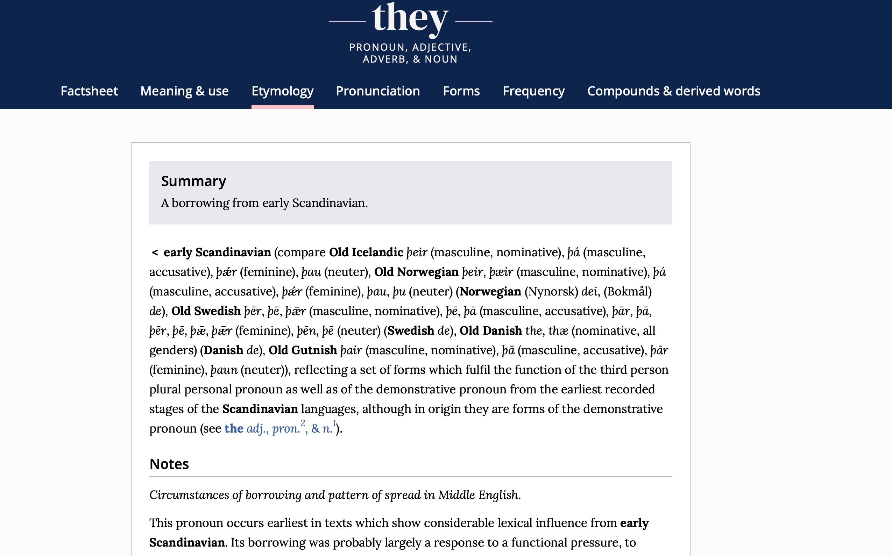
From OED online.
Notes:
Language – Old Norse loan words. OED, entry for ‘they’, etymology
Words – ransack, scare, die; fellow, ugly, window, knife, skirt, sky, ‘they, their, them’ (hie). Northern dialects: nay, lass, attle (intend), laik (play), mun (will).
Many loans date to after 1100 because of language death.

Slide 11
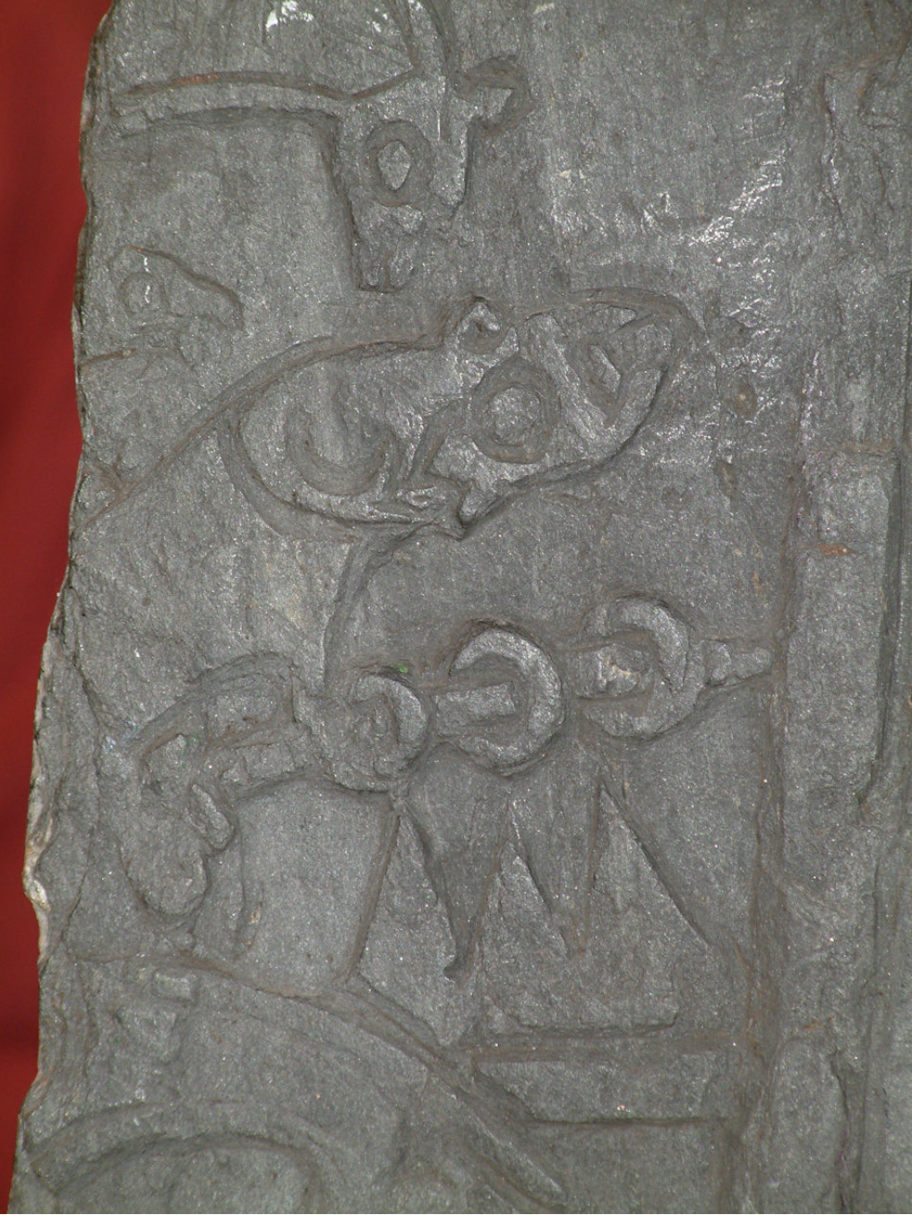
Gosforth
Cross,
Cumbria,
10th c.
Andreas Cross
121,
Isle of Man,
10th c.
Notes:
Visual Culture – archaelogy, Gosforth Cross, Cumbria. Sigurd Cross in the isle of man (Sigurd tasting the dragon’s blood): Andreas Cross 121.

Slide 12
Þa stod on stæðe, stiðlice clypode
wicinga ar, wordum mælde,
se on beot abead brimliþendra
ærænde to þam eorle, þær he on ofre stod:
“Me sendon to þe sæmen snelle,
heton þe secgan þæt þu most sendan raðe
beagas wið gebeorge; and eow betere is
þæt ge þisne garræs, mid gafole forgyldan
þon we swa hearde hilde dælon.
Ne þurfe we us spillan, gif ge spedað to þam;
we willað wið þam golde grið fæstnian.
Gyf þu þat gerædest, þe her ricost eart,
þæt þu þine leoda lysan wille,
syllan sæmannum on hyra sylfra dom
feoh wið freode, and niman frið æt us,
we willaþ mid þam sceattum us to scype gangan,
on flot feran, and eow friþes healdan”.
‘The Battle of Maldon’, ll. 25-41
Then stood on the bank, calling loudly,
the messenger of the Vikings, who made a speech,
boastfully delivered the seafarers’
message to the earl, as he stood on the bank:
“Brave seafarers have sent me to you,
commanded me to tell you to send quickly
rings in exchange for protection; and it’s better for you
that you buy off this spear-rush by paying tribute
than that we deal out such fierce battle.
We need not destroy each other, if you are rich enough.
We wish to establish a truce with the gold.
If you advise – who are most powerful here –
that you decide to redeem your people,
give to the seafarers at their own judgement
money for protection, and receive peace from us,
We will take the money and go to our ship,
Put out to sea and keep peace with you.”

Slide 13
Þa stod on stæðe, stiðlice clypode
wicinga ar, wordum mælde,
se on beot abead brimliþendra
ærænde to þam eorle, þær he on ofre stod:
“Me sendon to þe sæmen snelle,
heton þe secgan þæt þu most sendan raðe
beagas wið gebeorge; and eow betere is
þæt ge þisne garræs, mid gafole forgyldan
þon we swa hearde hilde dælon.
Ne þurfe we us spillan, gif ge spedað to þam;
we willað wið þam golde grið fæstnian.
Gyf þu þat gerædest, þe her ricost eart,
þæt þu þine leoda lysan wille,
syllan sæmannum on hyra sylfra dom
feoh wið freode, and niman frið æt us,
we willaþ mid þam sceattum us to scype gangan,
on flot feran, and eow friþes healdan”.
‘The Battle of Maldon’, ll. 25-41
OE eorl ‘nobleman, warrior, man’, cf. ON jarl ‘earl’
OE snelle ‘quick, active’,
cf. ON snjallr ‘brave, eloquent’
OE garræs ‘spear-rush’, cf. ON geirrás ‘spear-torrent, rush of spears’
OE grið ‘truce, peace, protection’ from ON grið, ‘truce, peace’
Notes:
Battle of Maldon

Slide 14
Þær stodon mid Wulfstane wigan unforhte,
Ælfere and Maccus, modige twegen […]
Maccus = ON Magnús
There stood with Wulfstan, warriors unafraid,
Ælfere and Maccus, a brave pair […]
Battle of Maldon, ll. 79-80

Slide 15
Hi bugon þa fram beaduwe þe þær beon noldon
Þær wearð Oddan bearn ærest on fleame,
Godric fram guþe […]
Odda = ON Oddr or Oddi
Then they turned from battle, those who did not wish to be there;
There the sons of Odda were first in flight,
Godric from the battle […]
Battle of Maldon, ll. 185-187

Slide 16
Forð þa eode Wistan,
Þurstanes sunu, wið þas secgas feaht;
he wæs on geþrange hyra þreora bana,
ær him Wigelines bearn on þam wæle læge.
Wistan = ON Vésteinn
Þurstan = ON Þorsteinn
Wigelin = OE feminine name?
Forth then went Wistan,
Thurstan’s son, fought against the men
He was the slayer of three in the throng,
Before Wigelin’s child lay among the slaughtered.
Battle of Maldon, ll. 297-300

Slide 17
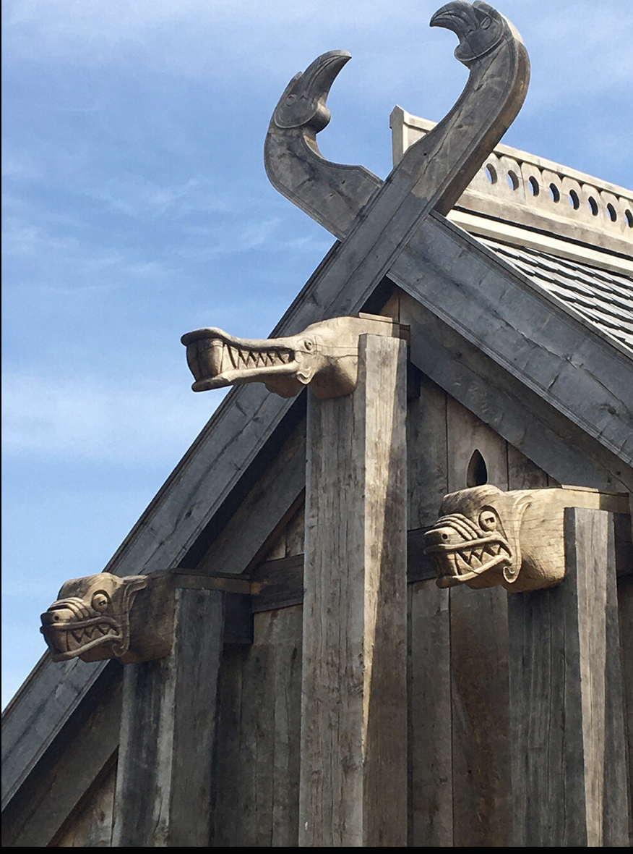
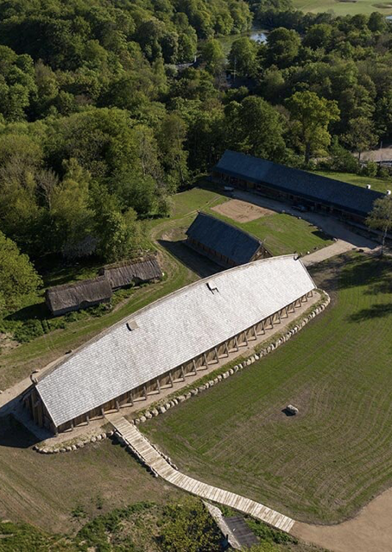
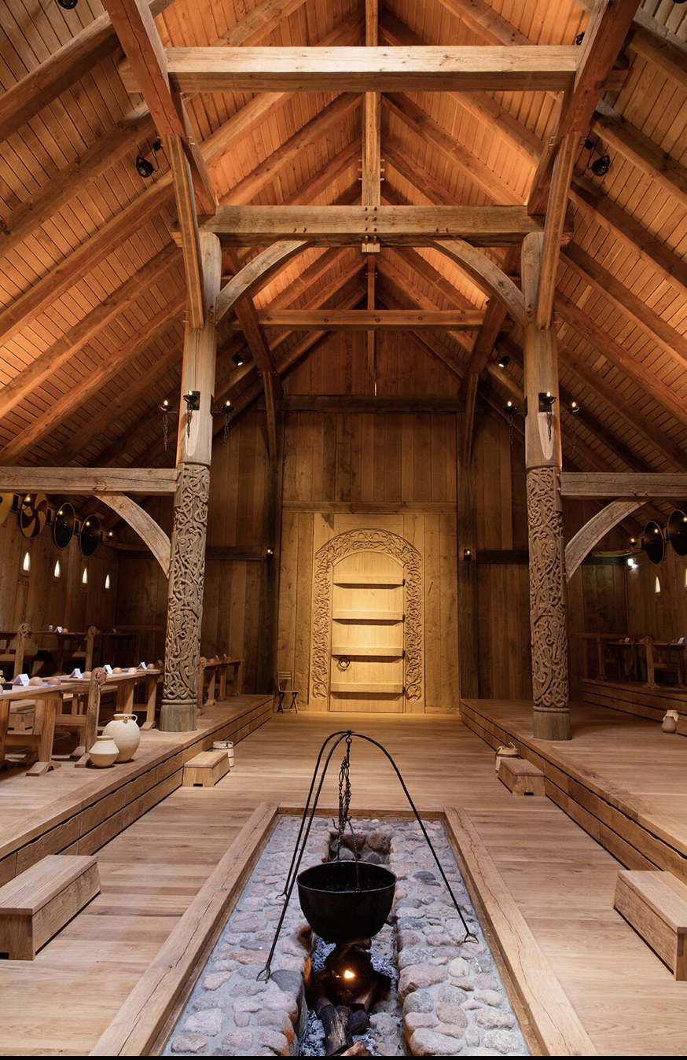
Notes:
Lerje, Denmark

Slide 18
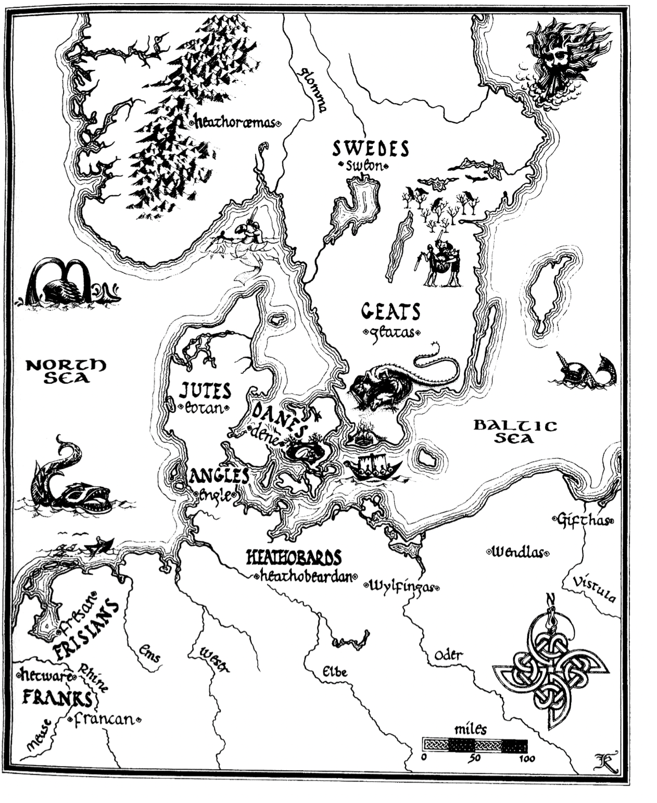
From Andy Orchard, A Critical Companion to Beowulf, p. xiii, drawn by Katherine Scarfe Beckett.
Notes:
From Andy Orchard, A Critical Companion to Beowulf. Usual sort of map that accompanies the poem, but very much modern understanding of Scandinavia.

Slide 19
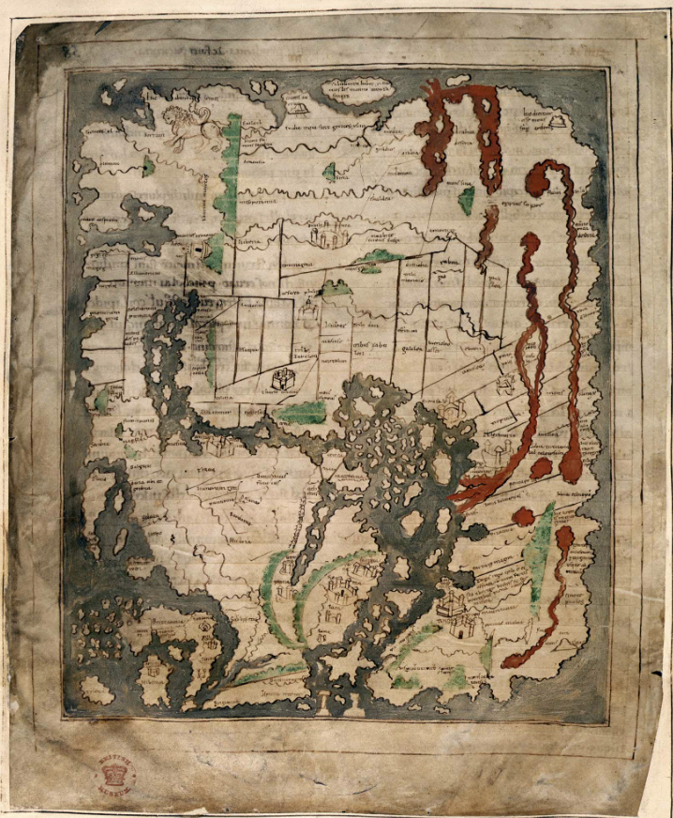
Cotton Tiberius map, c. 995-1050, Cotton MS Tib.B.5, fol. 56.
Notes:
Cotton Tiberius map, dating to c. 995-1050, in copy of Priscian’s Pereegesis. Cotton MS Tiberius B.5, fol. 56

Slide 20
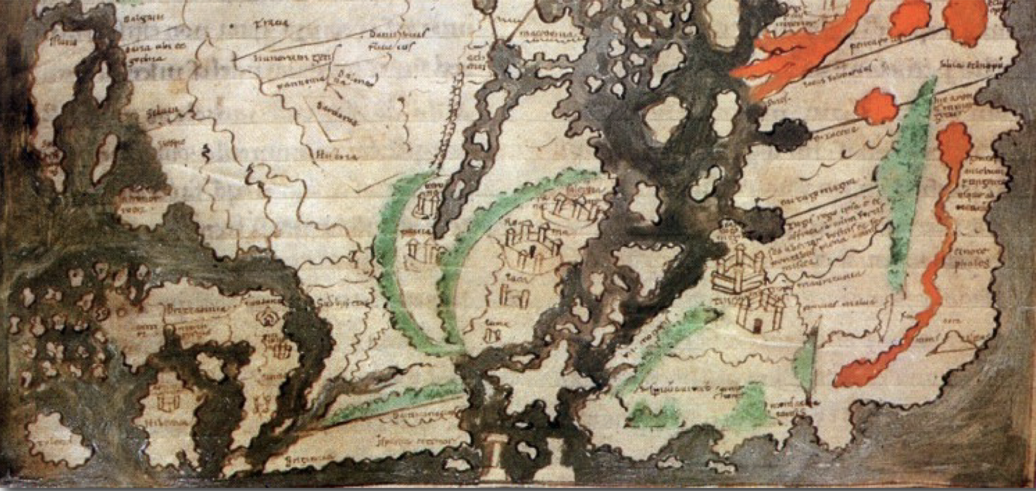
Notes:
Hiatt – Beowulf is about regional identity peripherality, exile, not homelands

Slide 21
welhwylc gecwæð,
þæt he fram Sigemundes secgan hyrde
ellendædum, uncuþes fela,
Wælsinges gewin, wide siðas,
þara þe gumena bearn gearwe ne wiston,
fæhðe ond fyrena, buton Fitela mid hine,
þonne he swulces hwæt secgan wolde,
eam his nefan, swa hie a wæron
at niða gehwam nydgesteallan;
hæfdon ealfela eotena cynnes
sweordum gesæged.
Beowulf, ll. 874-884
He told almost everything
that he had heard say about Sigemund,
his courageous deeds, many strange things
which the sons of men did not fully know –
the strife of Wæls’s son, his wide journeys,
feuds and crimes – except for Fitela with him,
to whom he told somewhat of these things,
uncle to his nephew, since they are always were,
in every conflict, companions at times of need;
They had put to sleep with swords many
of the giants’ kin.
Notes:
Beowulf

Slide 22
welhwylc gecwæð,
þæt he fram Sigemundes secgan hyrde
ellendædum, uncuþes fela,
Wælsinges gewin, wide siðas,
þara þe gumena bearn gearwe ne wiston,
fæhðe ond fyrena, buton Fitela mid hine,
þonne he swulces hwæt secgan wolde,
eam his nefan, swa hie a wæron
at niða gehwam nydgesteallan;
hæfdon ealfela eotena cynnes
sweordum gesæged.
Beowulf, ll. 874-884
Sigemund = ON Sigmundr
Fitela = ON Sinfjötli, Sigmundr’s sister’s son and Sigmundr’s son by his sister.
Notes:
Beowulf

Slide 23
uncuþes fela: ‘many a strange thing’. Could this refer to the incest or shapeshifting in Sigemund’s story?
welhwylc gecwæð,
þæt he fram Sigemundes secgan hyrde
ellendædum, uncuþes fela,
Wælsinges gewin, wide siðas,
þara þe gumena bearn gearwe ne wiston,
fæhðe ond fyrena, buton Fitela mid hine,
þonne he swulces hwæt secgan wolde,
eam his nefan, swa hie a wæron
at niða gehwam nydgesteallan;
hæfdon ealfela eotena cynnes
sweordum gesæged.
Beowulf, ll. 874-884
wide siðas: ‘wide journeys’. Could this allude to Sigemund’s time as an exile?
fæhðe ond fyrena: ‘feuds and crimes’. This half-line is also used of Grendel’s raids.
eam his nefan: uncle to his nephew. Does the OE poet know that Fitela is also Sigemund’s son?
Notes:
Beowulf

